Slide 1

Stochastic Simulations for HEUR solution
Gun Woo Park
Supervisor: Giovanni Ianniruberto
24 FEB 2016

Slide 2
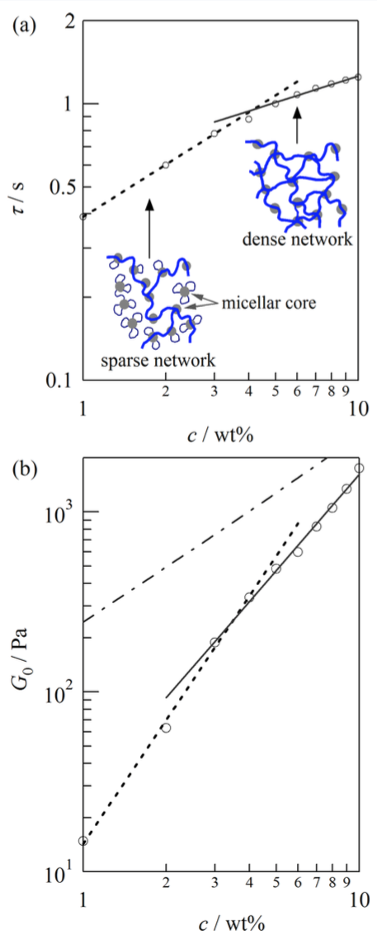
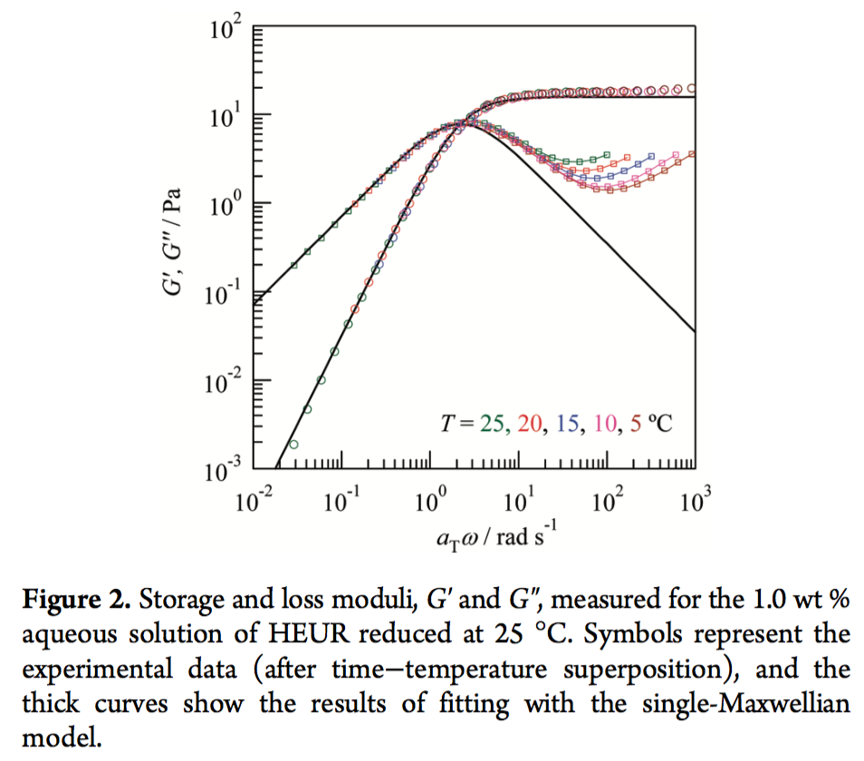
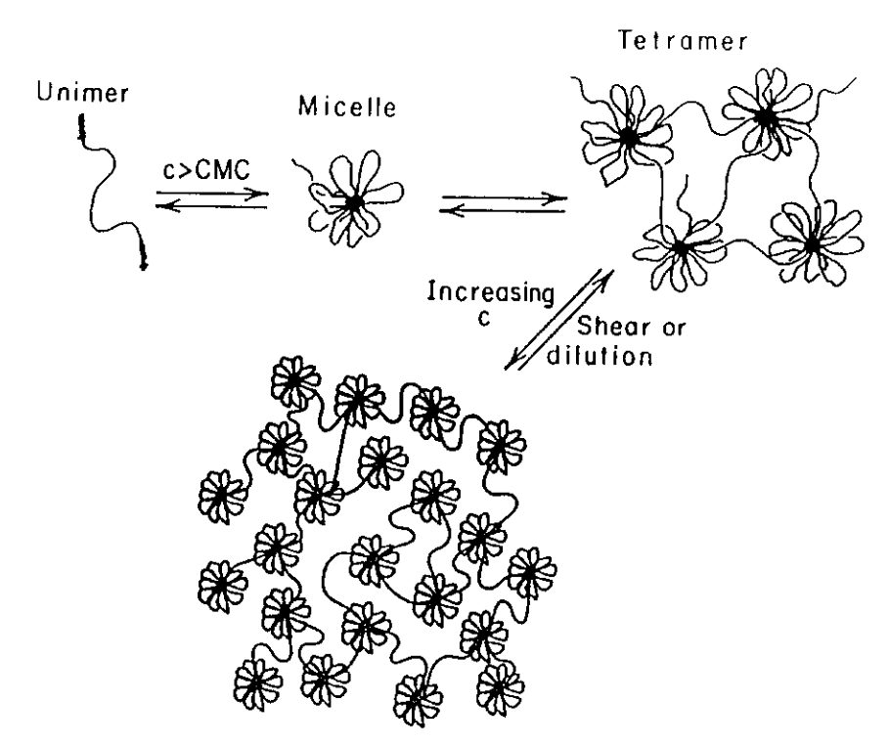
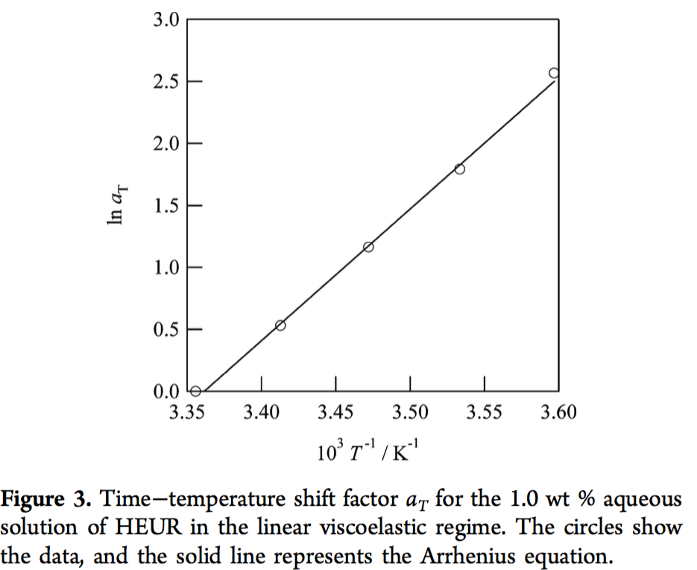
Introduction
Introduction | Rheological Nonlinearity | Simulation Method | Identification | Percolations | Conclusions and Remarks | Future Works
Suzuki et al. (2013)
Hydrophobically Modified Ethoxylated Urethane
Hydrophobic short end group
C_{n1}-[CH₂-CH₂-O]_{x}-C_{n2}
dissociation time
Hydrophilic PEO chain
plateau modulus
Annable et al. (1993): 10k, 20k, 35k PEO
Uneyama et al. (2012), Suzuki et al. (2012, 2013): 46k PEO
Xu et al. (1996)
Suzuki et al. (2012)

Slide 3
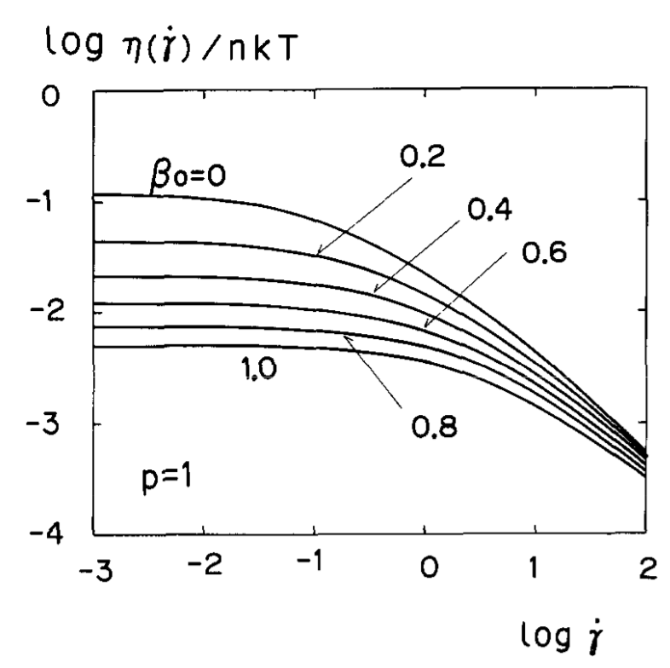
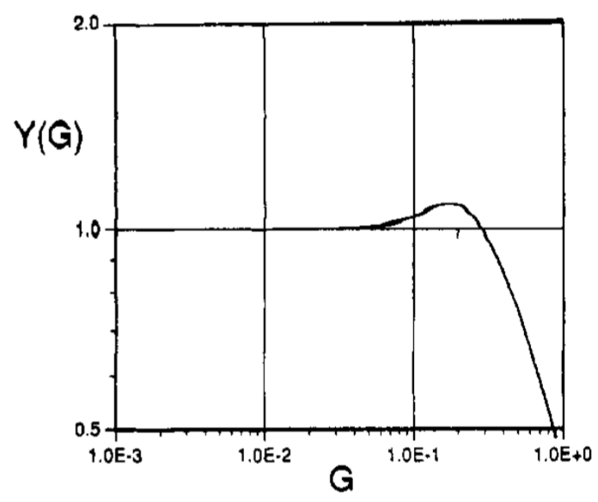
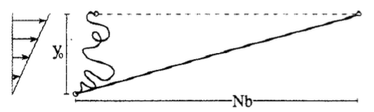
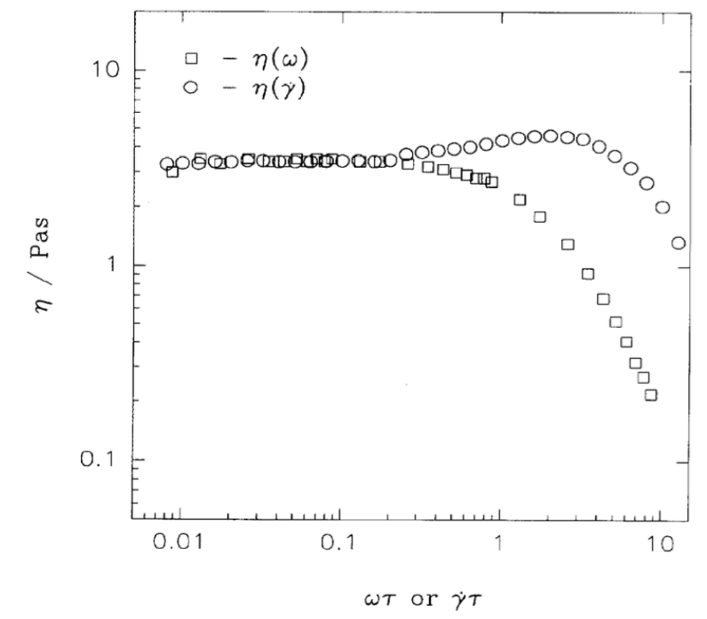
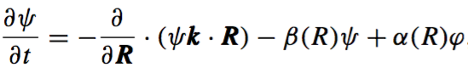
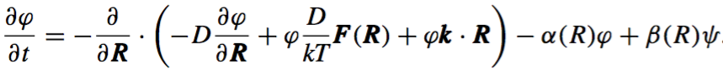
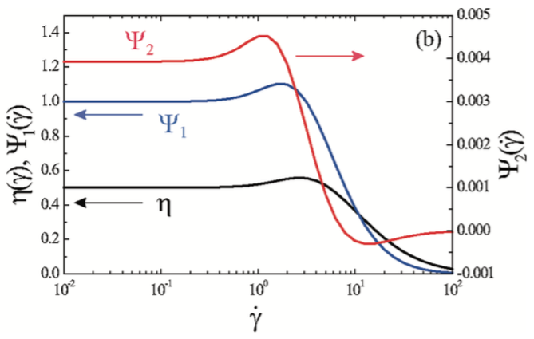
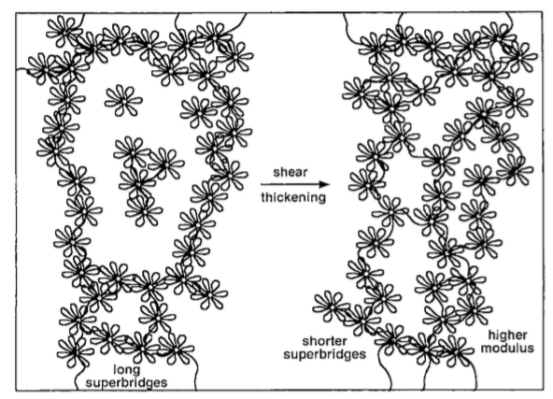
Shear Thickening
Introduction | Rheological Nonlinearity | Simulation Method | Identification | Percolations | Conclusions and Remarks | Future Works
Tanaka-Edwards unentangled thelechelic model (Tanaka and Edwards JNNFM 1992)
Non-Gaussian (FENE) TE model (and FP model)
(Marrucci et al. Macromol. 1993)
Pendant chain relaxation
(Vaccaro and Marrucci JNNFM 2000, Tripathi et al. Macromol. 2006)
Steady shear viscosity
Dynamic viscosity
Numerical studies inspired by TE, FENE, and Vaccaro and Marruci
(Koga and Tanaka Macromol. 2010)
Annable et al. (1993)
35k PEO, 1.5wt%, 298K
Shear-induced strand formation
(Tam et al. 1998)

Slide 4
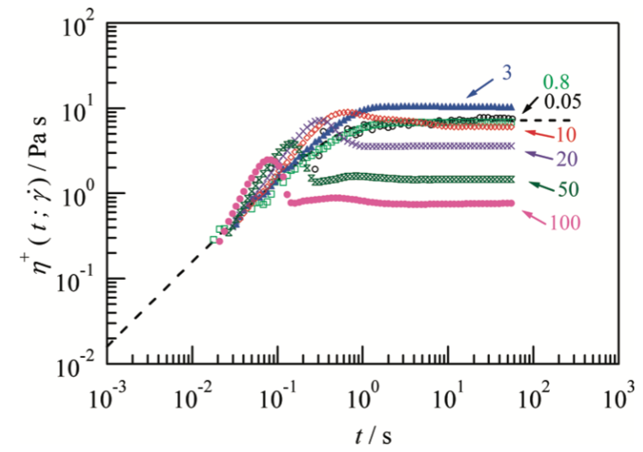
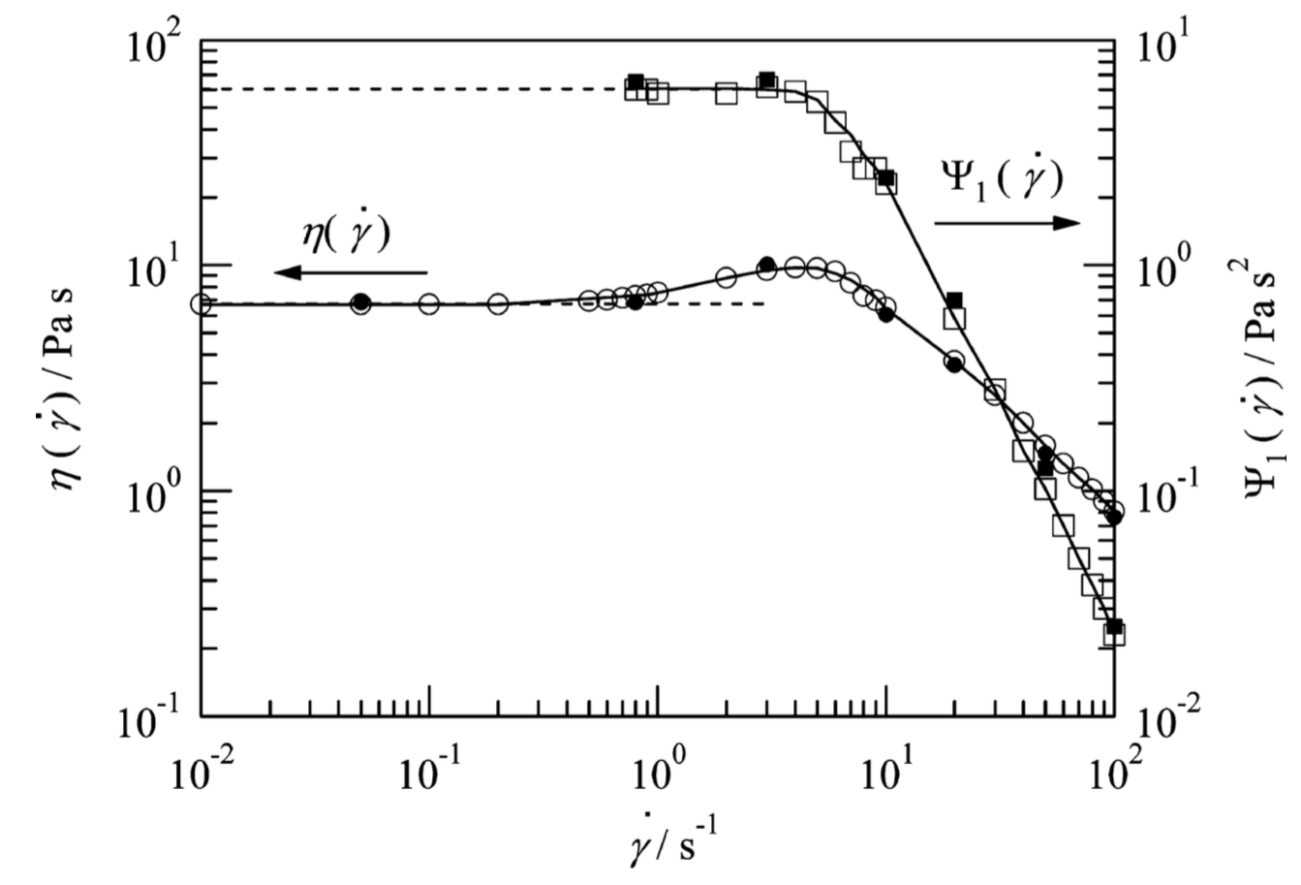
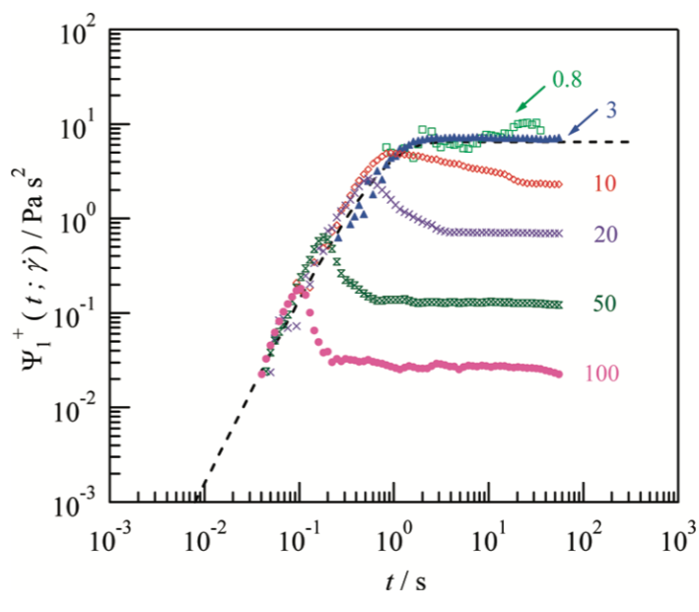
Rheological Nonlinearity
Introduction | Rheological Nonlinearity | Simulation Method | Identification | Percolations | Conclusions and Remarks | Future Works
strain hardening
Suzuki et al. (2012)
46k PEO, 1wt%, 298K
Linear
Shear thickening

Slide 5
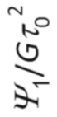
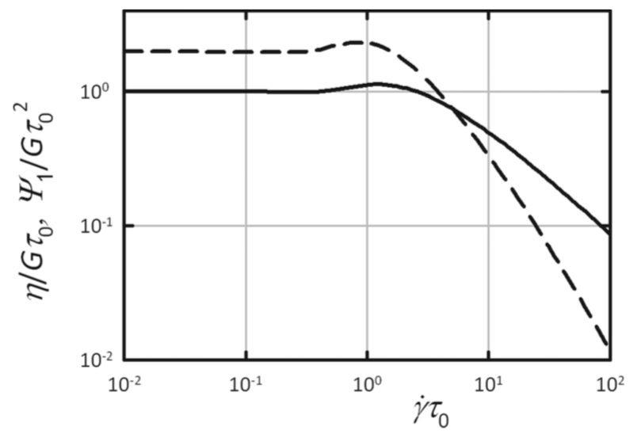
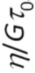
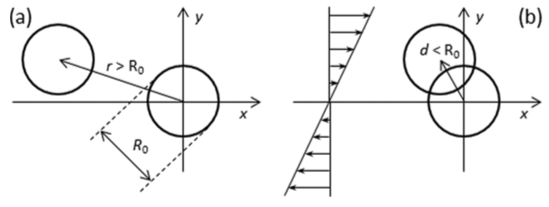
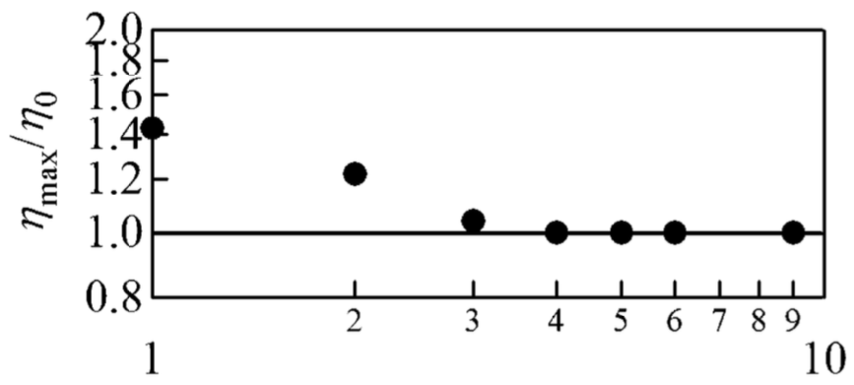
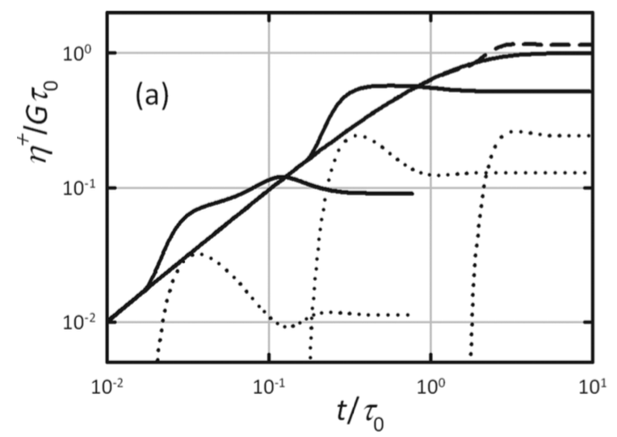
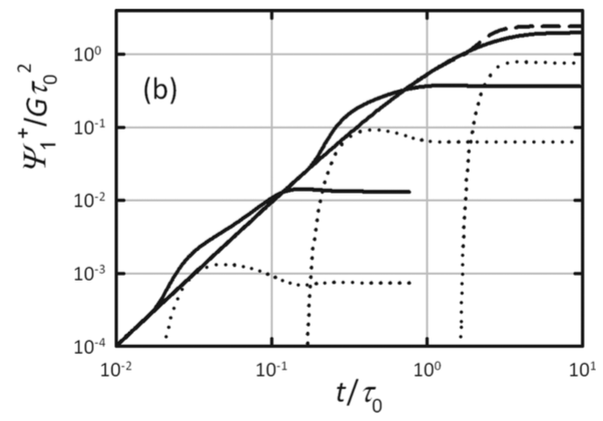
Micelles Interaction Model
Introduction | Rheological Nonlinearity | Simulation Method | Identification | Percolations | Conclusions and Remarks | Future Works
Ianniruberto and Marrucci (2015)
Suzuki et al. (2013)
46k PEO, 208K
Sparse network
Dense network
wt%
Micelle interaction contribution

Slide 6
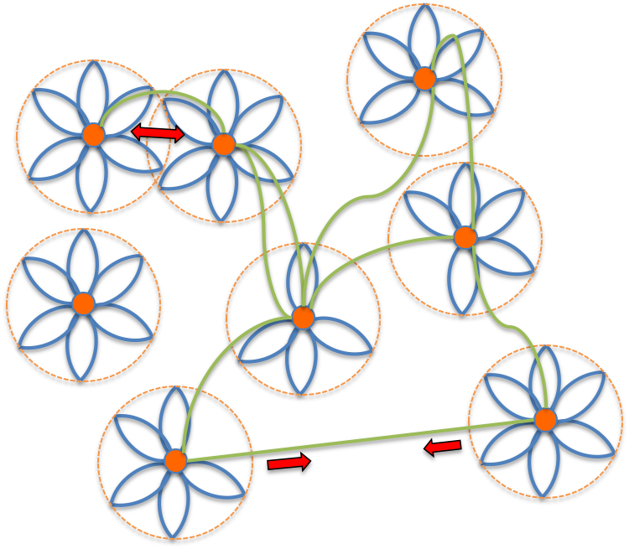
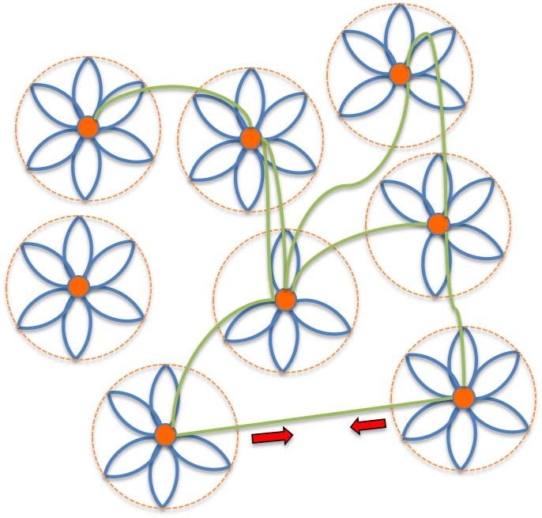
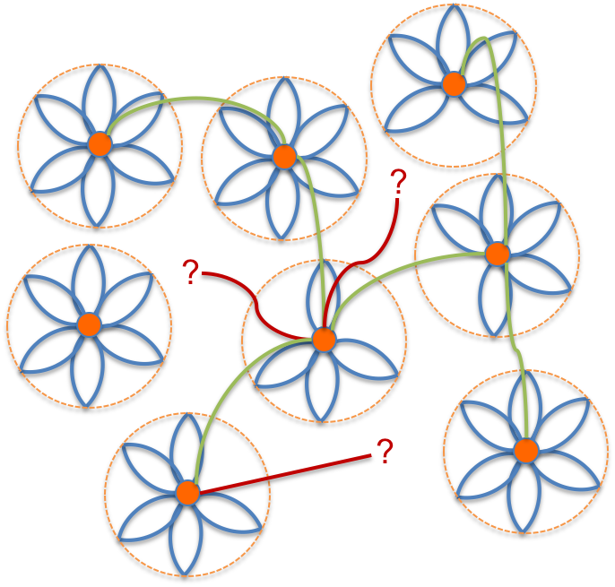
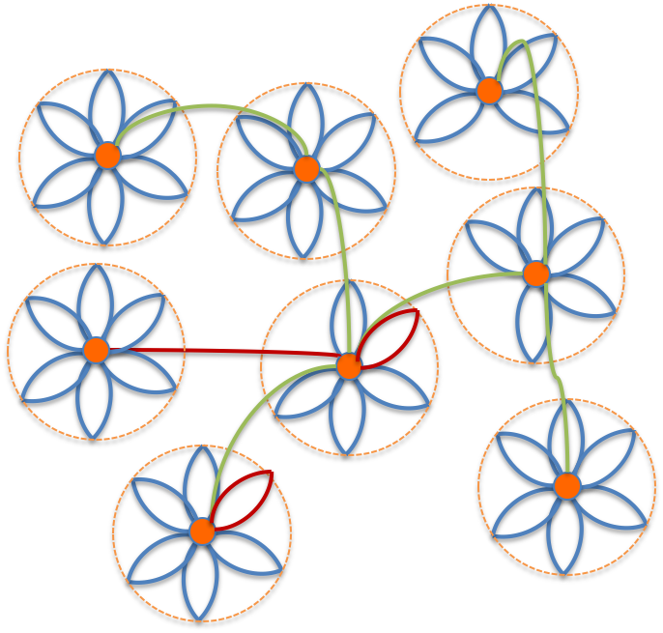
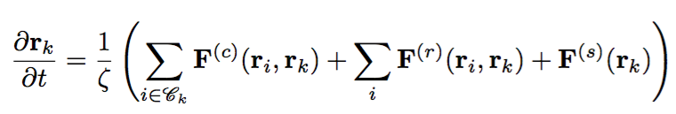
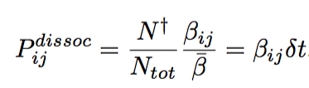
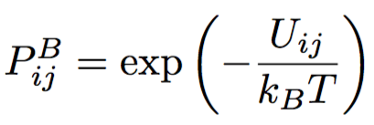
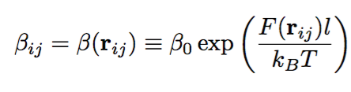
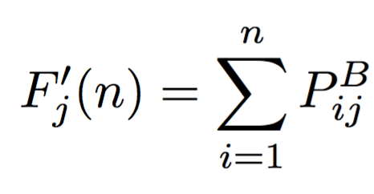
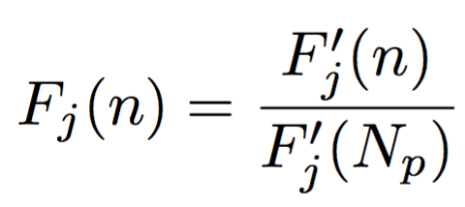
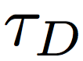
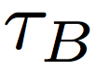
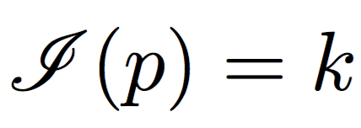
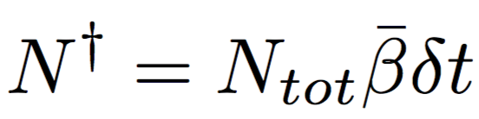
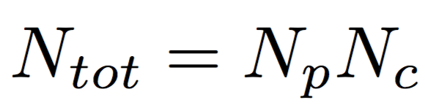
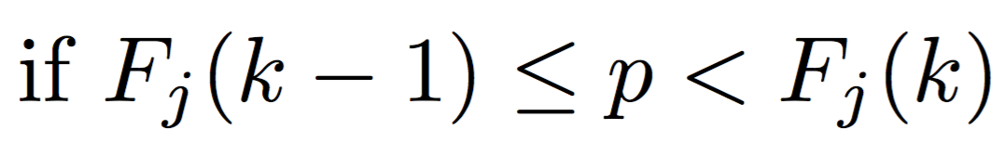
Stochastic Simulation for HEUR Solution
Introduction | Rheological Nonlinearity | Simulation Method | Identification | Percolations | Conclusions and Remarks | Future Works
Repulsive contribution
Brownian motion
Topological information
Dissociation
Association
Dissociation probability
Boltzmann distribution
,
Detachment frequency
Index function
Suzuki et al. (2012)

Slide 7
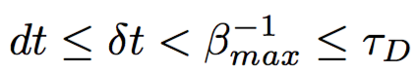
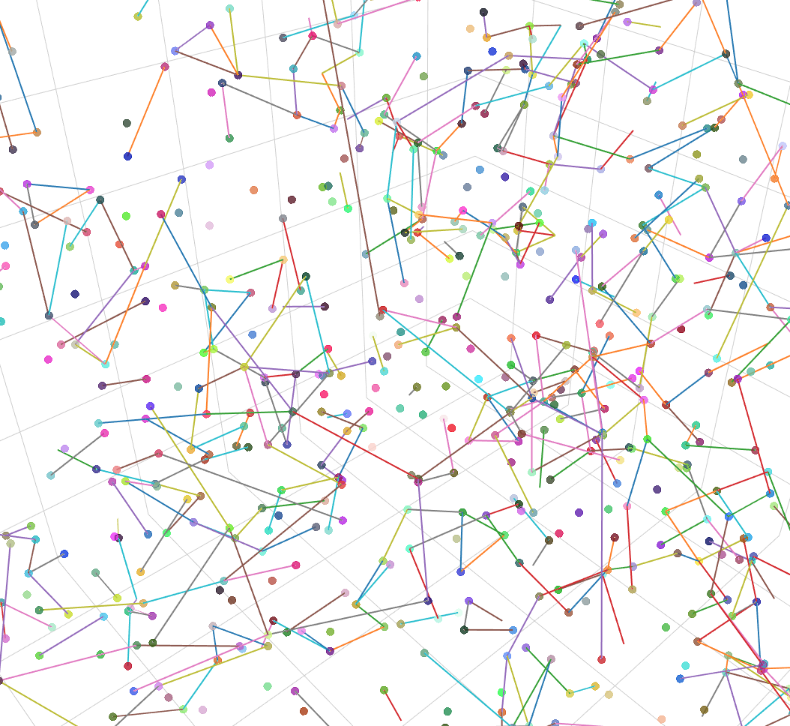
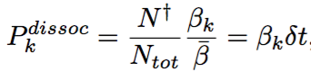
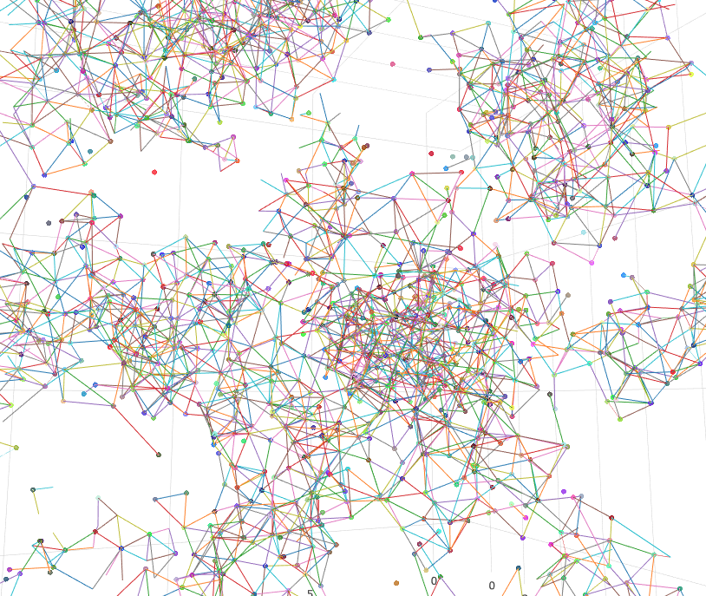
Time Step for Topological Update
Introduction | Rheological Nonlinearity | Simulation Method | Identification | Percolations | Conclusions and Remarks | Future Works
Time step for Brownian update
Time step for topological update
0.1, lightly associated
1, densely aggregated
Same RDF

Slide 8
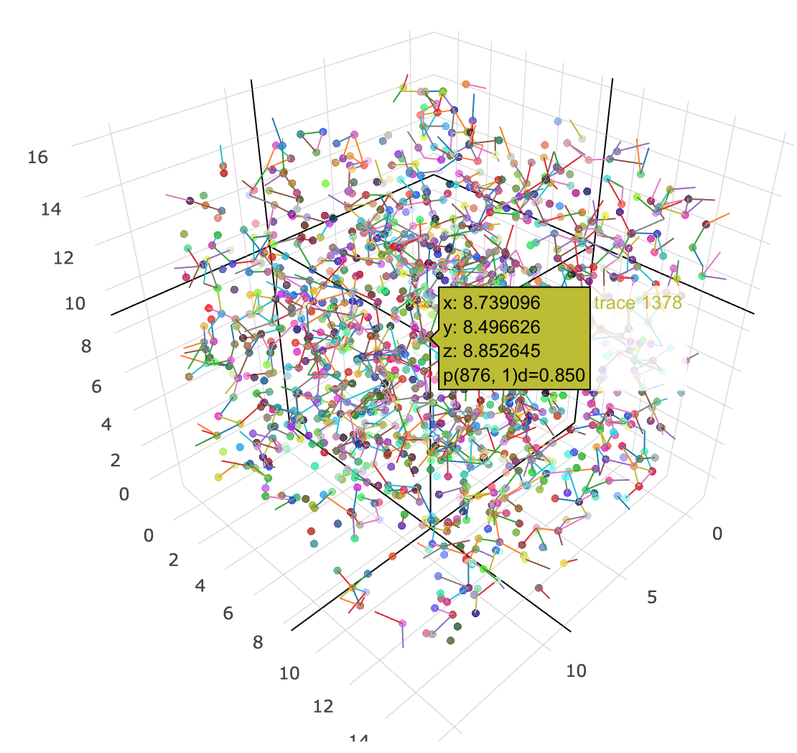
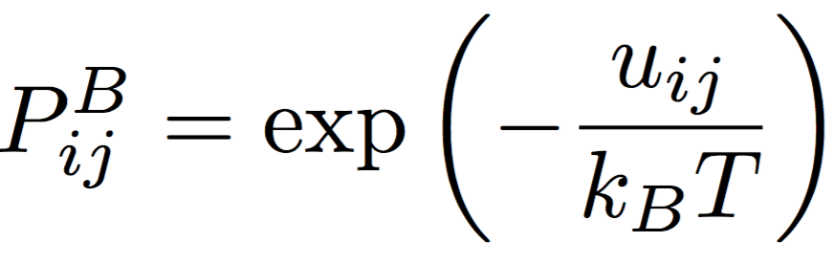
Association Distribution
Introduction | Rheological Nonlinearity | Simulation Method | Identification | Percolations | Conclusions and Remarks | Future Works
Repulsion effect
No repulsion
N_{P}=1350, L_{D}=15, 3D

Slide 9
Equilibration
Introduction | Rheological Nonlinearity | Simulation Method | Identification | Percolations | Conclusions and Remarks | Future Works
N_{P}=1350, L_{D}=15, 3D
Instantaneous radial distribution function
Isotropy for Association
Over-correlated (association)
Diagonal component for <RR>
Off-diagonal component for <RR>
Under-correated (repulsion)

Slide 10
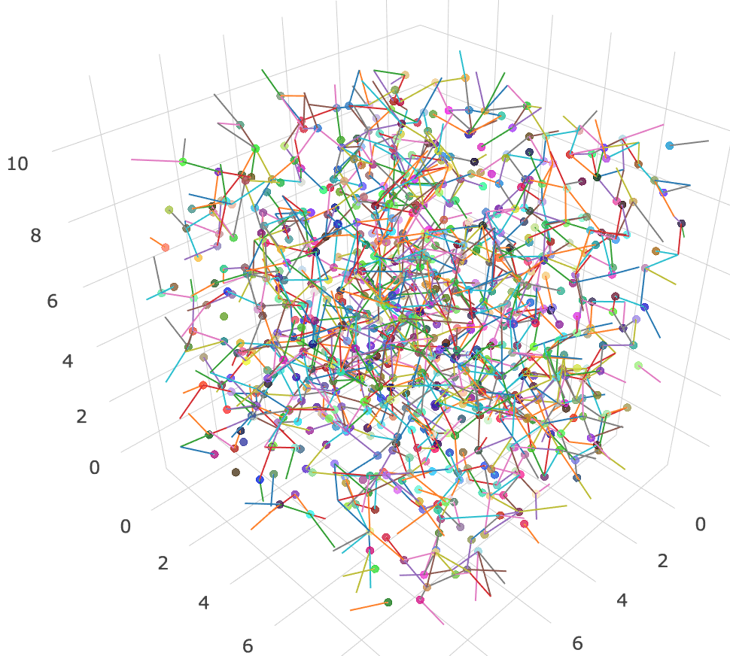
Percolation Identification
Introduction | Rheological Nonlinearity | Simulation Method | Identification | Percolations | Conclusions and Remarks | Future Works
Travel algorithm: depth first search (DFS) for undirected graph structure
Densely percolated
Many isolated percolated clusters
Percolation symbol
along x
along y
along z

Slide 11
Conclusions and Remarks
Introduction | Rheological Nonlinearity | Simulation Method | Identification | Percolations | Conclusions and Remarks | Future Works
Detailed mechanisms of shear thickening for HEUR solution are still controversial
Shear thickening effects depend on the network structure (sparse or dense)
A new stochastic simulation algorithm accounts for repulsive interactions between micelle because anisotropic flow-induced collisions among micelles are believed to be responsible for shear thickening
Equilibrium structure is identified by looking at association distribution, isotropy, RDF, structure factor, and percolation

Slide 12
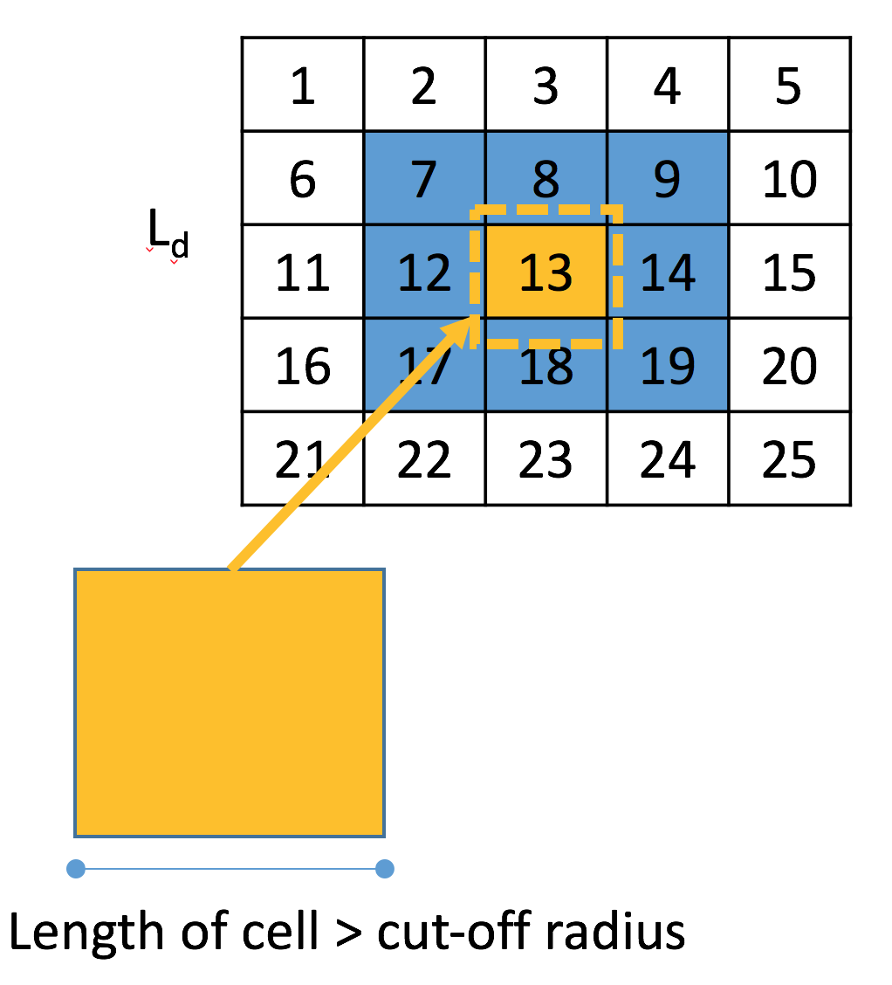
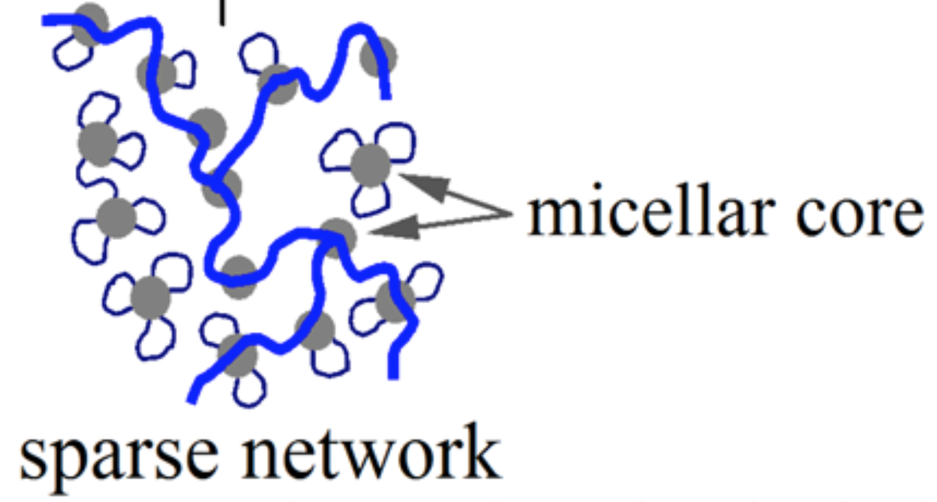
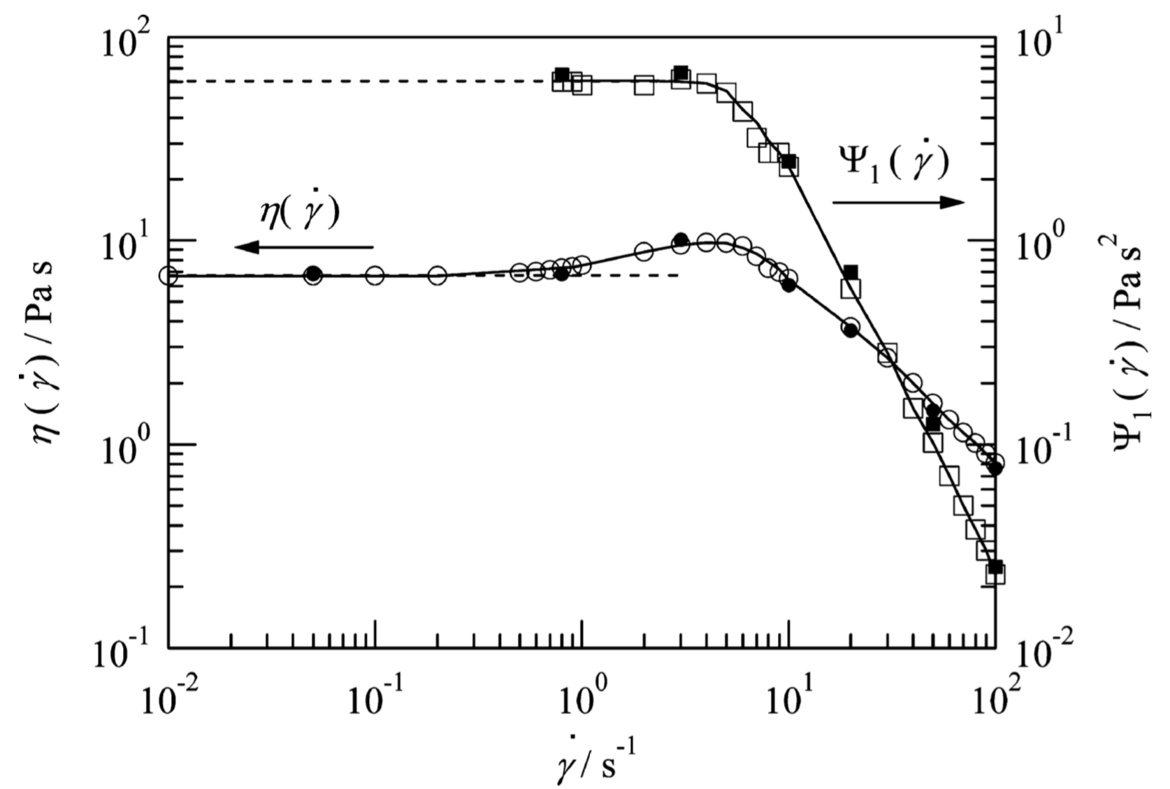
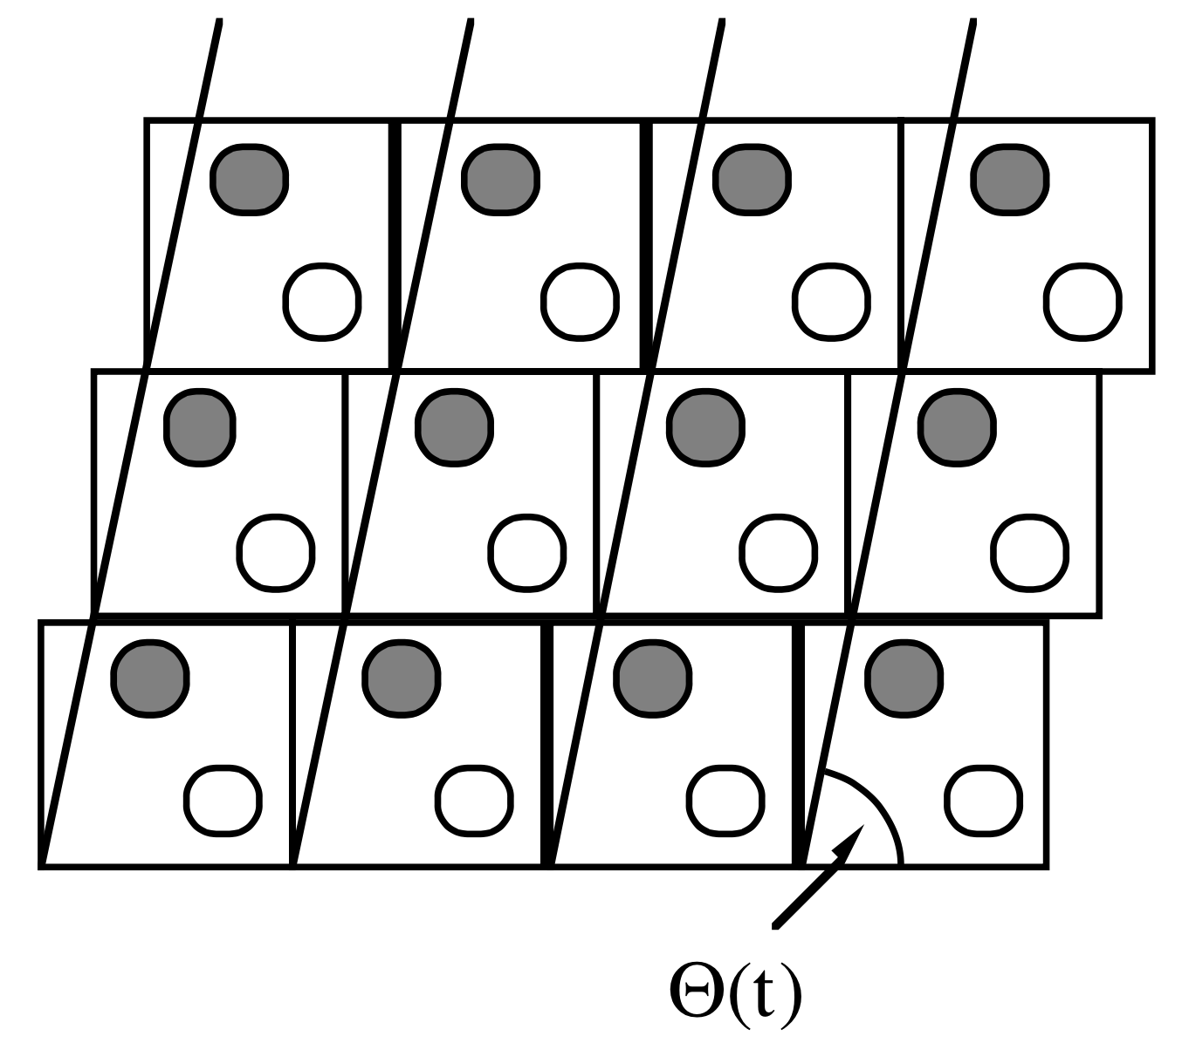
Future Works
Introduction | Rheological Nonlinearity | Simulation Method | Identification | Percolations | Conclusions and Remarks | Future Works
Static Variables
Computational Economy
Dynamical Test
Cell list
Rheological quantities to capture dynamical details
With many parameter space, the sparsely percolated network structure should be generated with reasonable number of association
Parallelization for topological update
(the Brownian update is only parallelized)

Slide 13
References
F. Tanaka and S.F. Edwards, Journal of Non-Newtonian Fluid Mechanics 43, 247 (1992).
G. Marrucci, S. Bhargava, and S.L. Cooper, Macromolecules 26, 6483 (1993).
T. Annable, R. Buscall, and R. Ettelaie, Journal of Rheology (1993).
A.N. Semenov, I.A. NYRKOVA, and M.E. Cates, Macromolecules 28, 7879 (1995).
B. Van den Brule and P.J. Hoogerbrugge, Journal of Non-Newtonian Fluid (1995).
B. Xu, A. Yekta, L. Li, Z. Masoumi, and M.A. Winnik, Colloids and Surfaces a-Physicochemical and Engineering Aspects 112, 239 (1996).
K.C. Tam, R.D. Jenkins, M.A. Winnik, and D.R. Bassett, Macromolecules 31, 4149 (1998).
J.G. Hernández Cifre, T.M.A.O.M. Barenbrug, J.D. Schieber, and B.H.A.A. van den Brule, Journal of Non-Newtonian Fluid Mechanics 113, 73 (2003).
L. Pellens, R. Gamez Corrales, and J. Mewis, Journal of Rheology 48, 379 (2004).
F. Tanaka and T. Koga, Macromolecules 39, 5913 (2006).
J.G. Hernández Cifre, R. Pamies, A.L. Kjøniksen, K.D. Knudsen, B. Nyström, and J. García de la Torre, Journal of Non-Newtonian Fluid Mechanics 146, 3 (2007).
T. Koga and F. Tanaka, Macromolecules 43, 3052 (2010).
S. Suzuki, T. Uneyama, T. Inoue, and H. Watanabe, Macromolecules 45, 888 (2012).
T. Uneyama, S. Suzuki, and H. Watanabe, Physical Review E 86(3), 1 (2012).
S. Suzuki, T. Uneyama, and H. Watanabe, Macromolecules 46, 3497 (2013).
G. Ianniruberto and G. Marrucci, Macromolecules 48, 5439 (2015).
F. Yuan and R.G. Larson, J. Phys. Chem. B 119, 12540 (2015).

Slide 14
Acknowledgements
Giuseppe Marrucci
Antonio Brasiello

